Slide 1

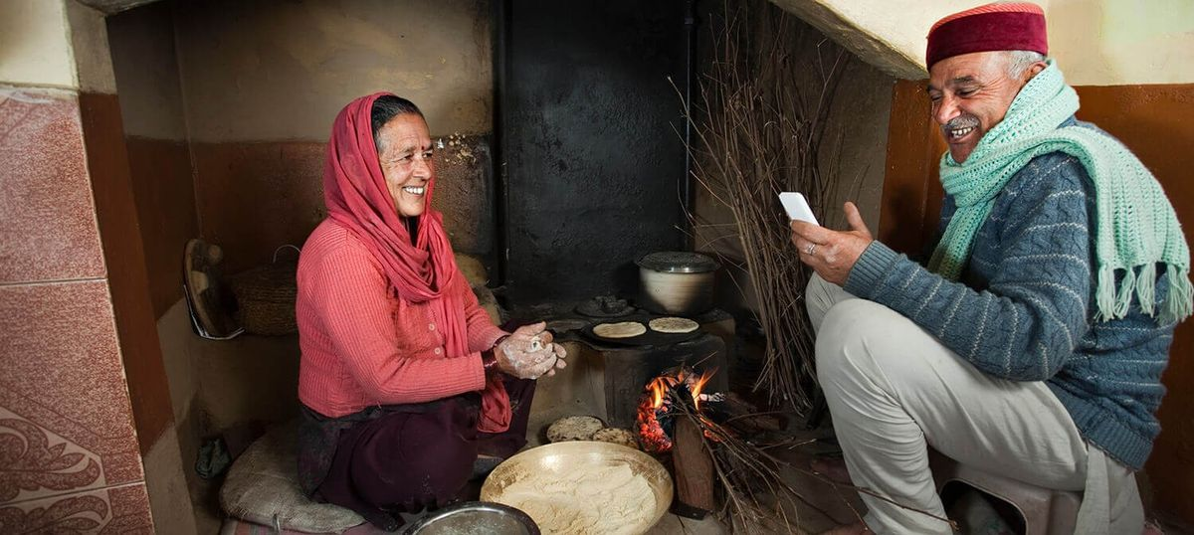




Reaching
the Last
Mile
Presented By: NPCI officials

Slide 2

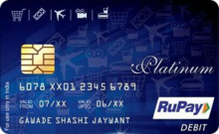

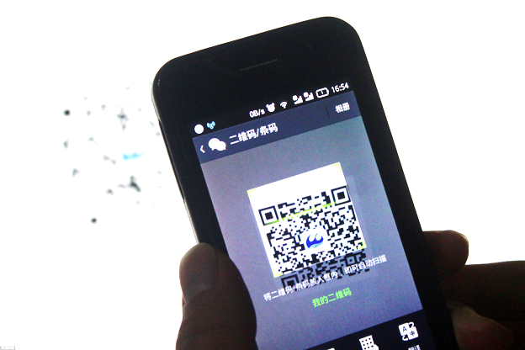
Products Offered by NPCI
RuPay Card
PoS
Aadhaar
AePS
e-KYC
Mobile
BHIM
e-com
ABPS
BHIM Aadhaar
ATM
*99#
Bharat QR

Slide 3
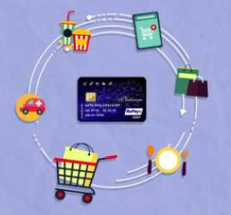

Bank Debit Cards
How To Apply
Approach nearest Bank Branch
Card Activation and PIN
Go to Bank ATM or PoS and do a transaction like balance checking.
Card Usage
ATM – Cash Withdrawal
Debit Card linked to the Account is setup
Card and PIN sent by Bank separately
Change the PIN allotted by the bank immediately at the nearest ATM
PoS – Purchases at Merchant Outlets
Online – E-commerce transactions

Slide 4
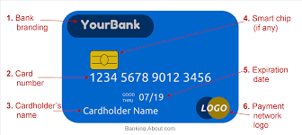
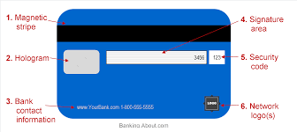
How a Debit Card looks ?

Slide 5

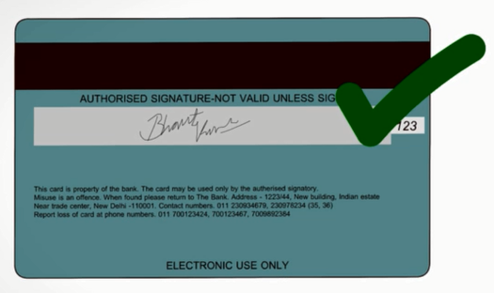
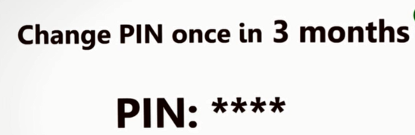
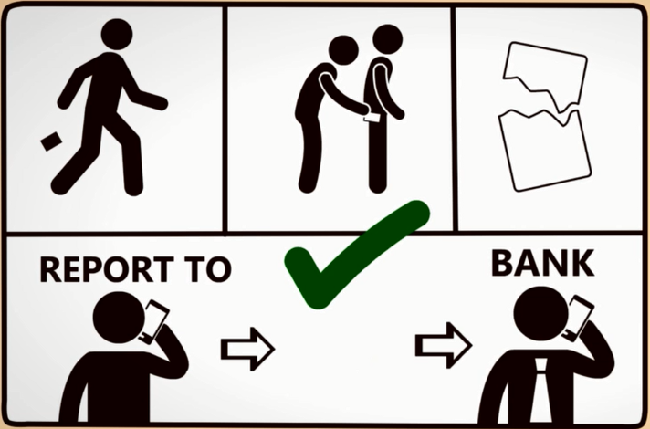


Cards – Usage Guidelines
  Keep the card at a safe place
  Note down the card details in a safe and secure place.
  Sign on the backside of the card.
  Inform the bank if card is lost or stolen.
  Change the PIN assigned by the Bank for secured usage.
  D
  O
  s
  Do not allow your card to be used by any other
  unauthorized individual.
  Do not write the PIN on the card for security reasons.
  Do not share the card details like the PIN, CVV, card expiry date, etc to anyone.
  D
  O
  N
  T
  s

Slide 6

Insurance Feature on RuPay Cards
  Insurance Coverage of Rs. 1 lakh
  Coverage for accidental death and Permanent Total disability only
  Eligibility:
  Minimum one successful transaction to be done (financial or non-financial) within 90 days prior to accident (for RuPay card holders)
  Compensation on only 1 eligible RuPay card per card holder in case of multiple cards held by
  card holder.

Slide 7
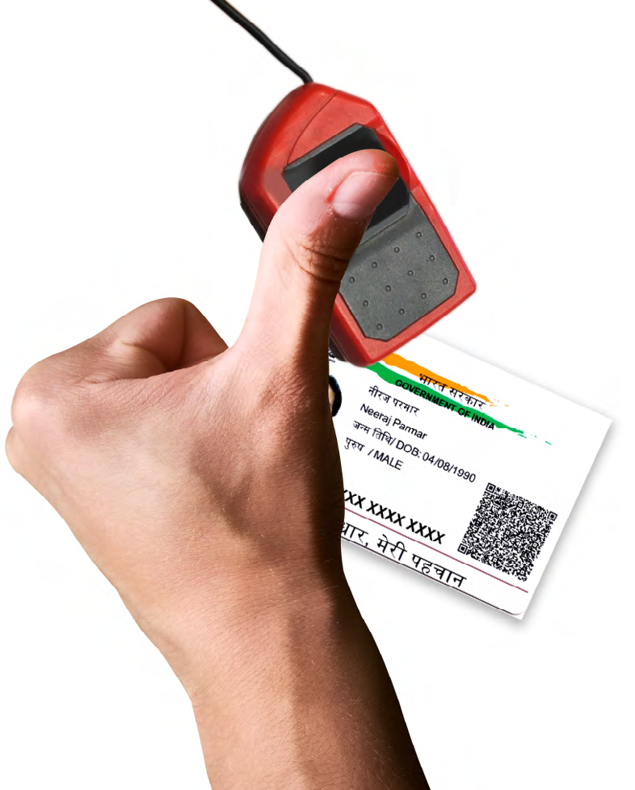
Aadhaar Enabled Payment System
Services offered
Balance Enquiry
Cash Deposit
Cash Withdrawal
eKYC
Aadhaar to Aadhaar Fund Transfer

Slide 8
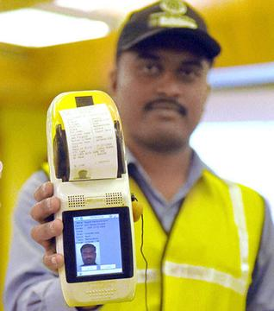
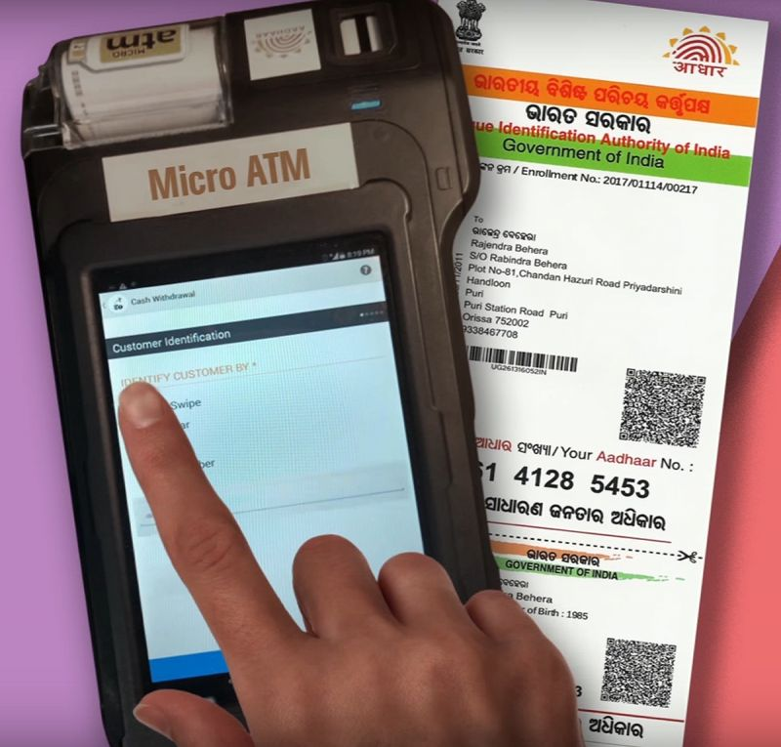
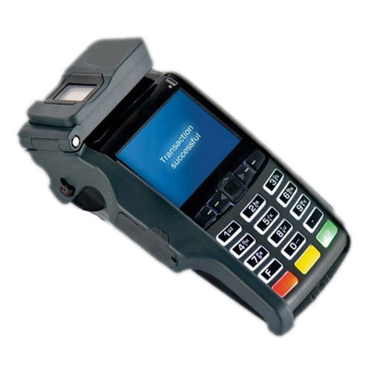

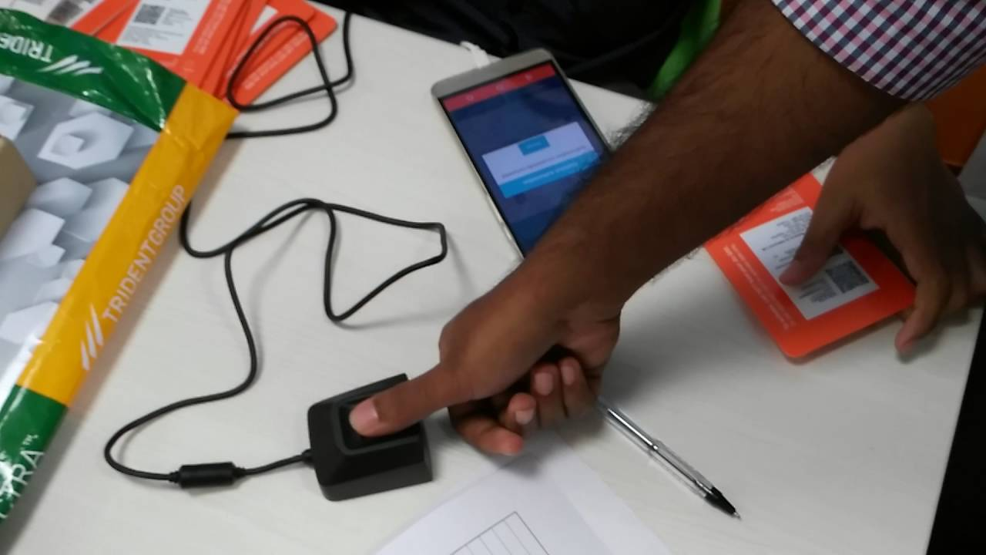
How AePS works?
Go to a Micro ATM or
Banking Correspondent
Micro ATM
Provide Bank Name, Aadhaar Number and transaction to be done
Transaction is successful
Provide Fingerprint on the scanner

Slide 9
BHIM (Bharat Interface for Money)
BHIM App
Simple, easy and quick payment transactions using UPI
Account to Account payment instantly
Services offered
Send money
Benefits
Single app for sending and receiving money
Collect money using Mobile number or Payment address
Request Money
Scan and Pay
Transactions
Profile
Bank Account
12 Regional languages, single interface
QR Code based payments
Mobile no and VPA used for Payments
24x7, 365 days instantaneous money transfer
Monetary Benefits of Referral Scheme

Slide 10
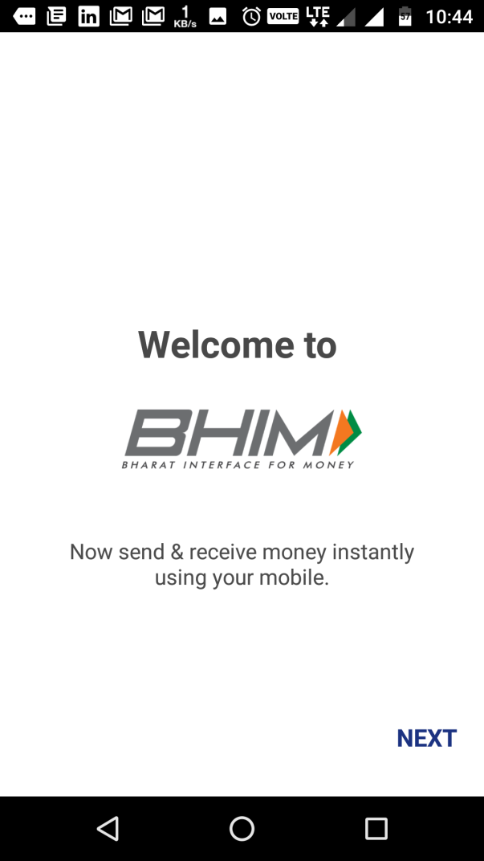
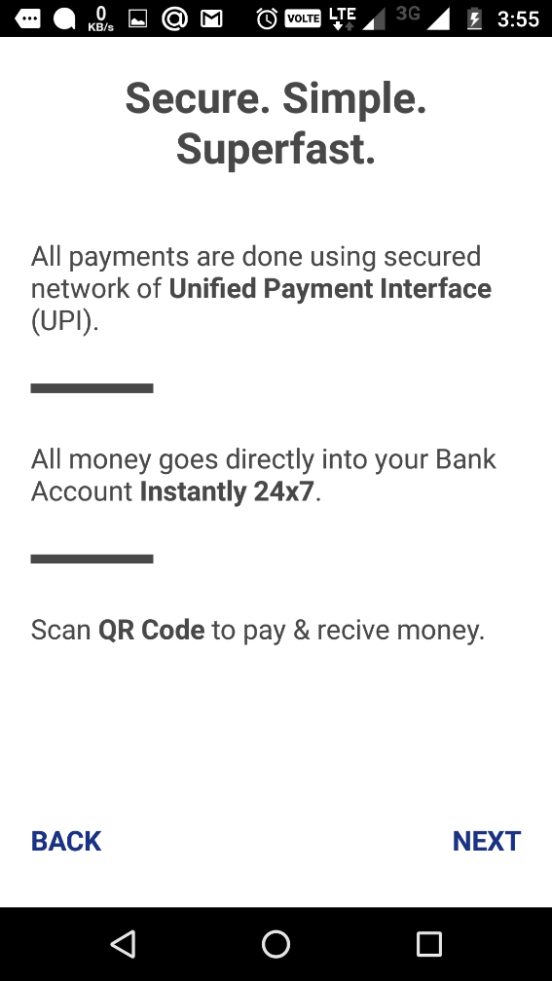
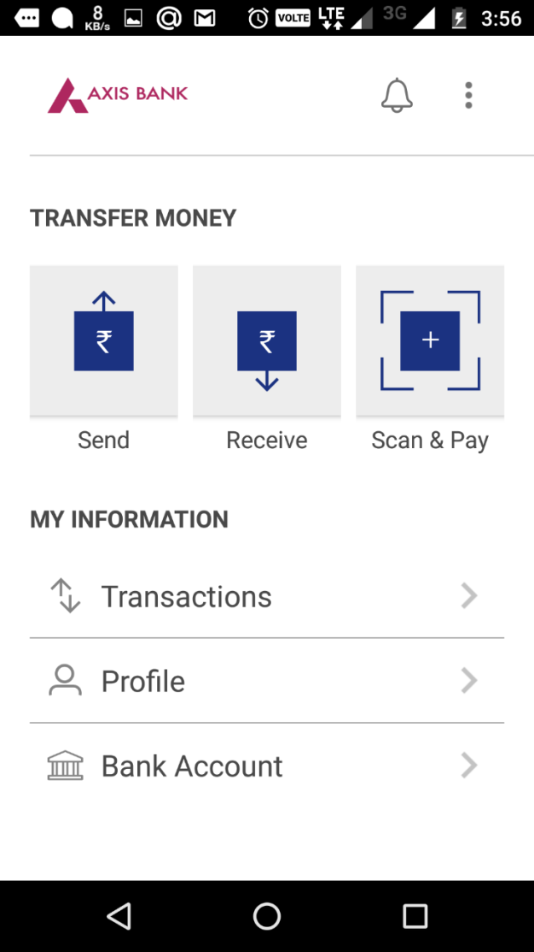
How BHIM works ?

Slide 11
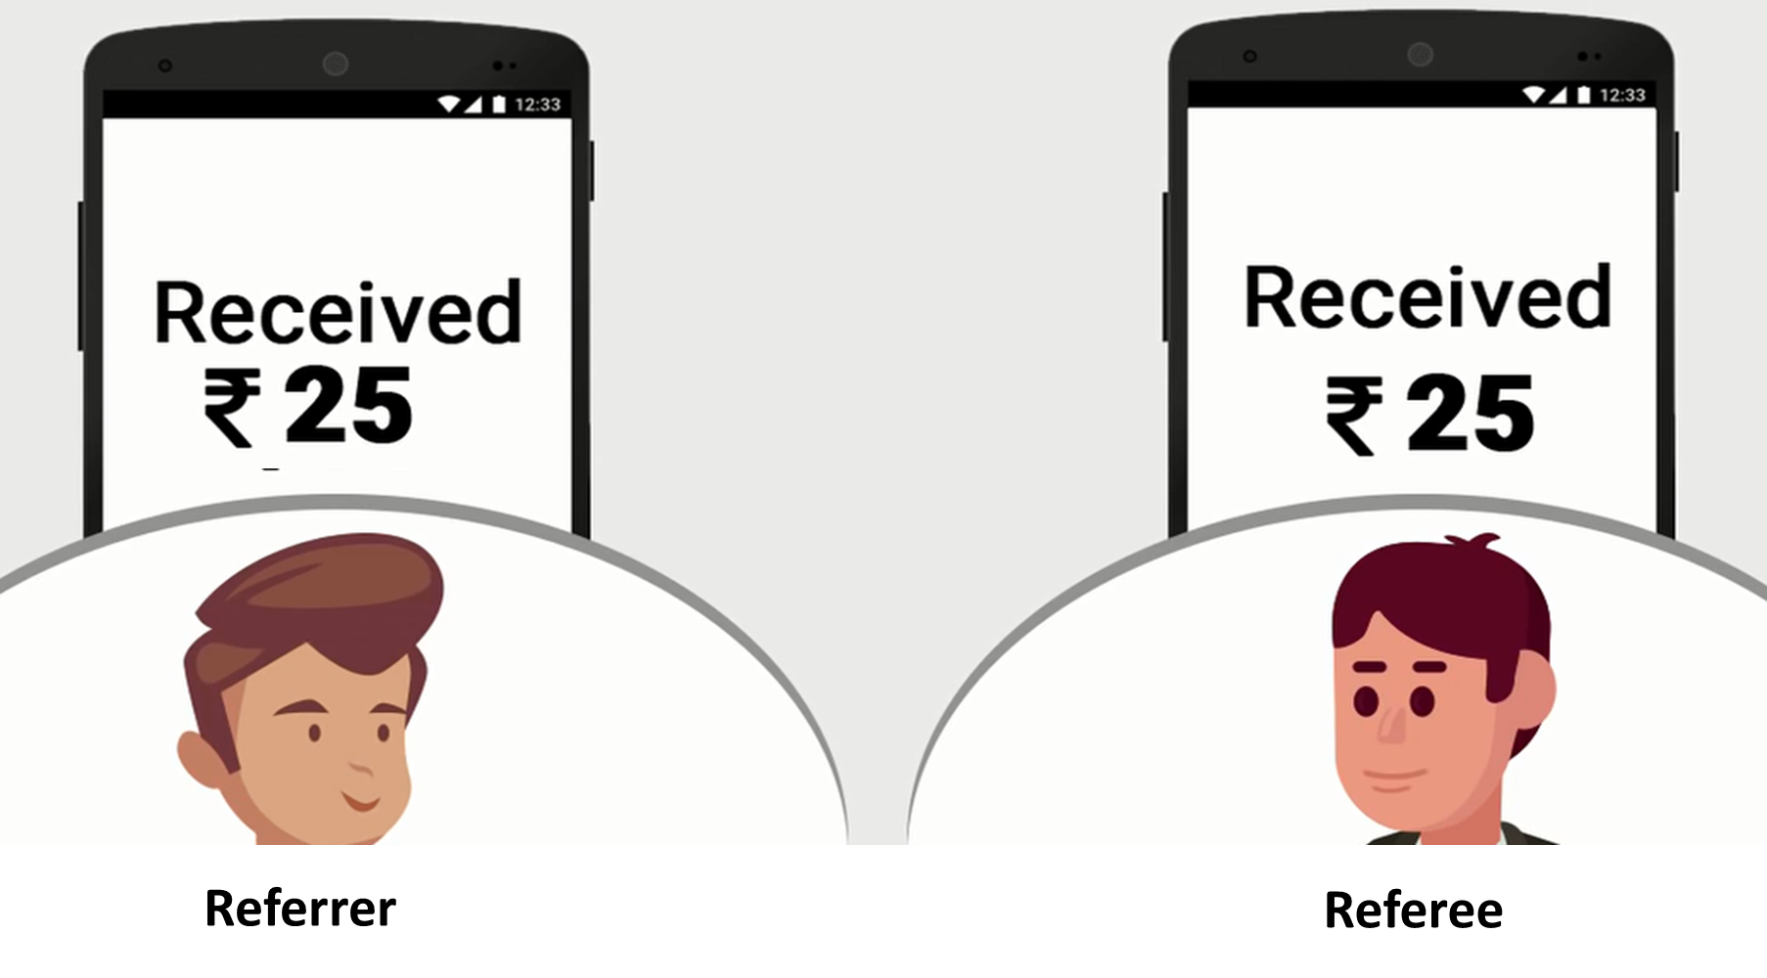
BHIM Referral Scheme
  Scheme introduced by Government of India
  Incentivise existing BHIM user to bring new users on the BHIM platform
  Referee (who successfully enters the referral code) has to perform 3 successful financial transactions upto Rs. 50 (to any valid UPI user)
  Total transaction value should be equal to or more than Rs. 50.
  Maximum referral amount that can be won is Rs. 25,000
  Bonus amount will be credited to the respective bank accounts of referrer and referee after meeting eligibility criteria

Slide 12
*99# (BHIM without Internet)
*99#
Mobile Banking Service for Financial and non-Financial Transactions
Mobile Number linked to Bank Account
Services offered
Fund Transfer
Benefits
Simplicity – User required to dial short code
Mobile phone on GSM network
Check Balance
My Profile
Pending Requests
Available in 12 regional languages
Works without Internet – uses voice connectivity
24x7, 365 days instantaneous money transfer
QSAM Services -*99*99#
Transactions

Slide 13

BHIM Aadhaar
BHIM Aadhaar
Facilitates digital payments using thumb imprint on a merchant’s biometric enabled device
Features
Only Aadhaar number linked to Bank account required for making payments.
Benefits
No need to carry any credit/debit card, cash, cheque or mobile wallets.
App is based on UPI
App made for merchants and shopkeepers but payers enjoy the benefits
Fingerprints used for authentication.
No need to remember passwords, Card PIN and wait for OTP.
Reduction of PoS terminals.
Customer does not need to download any app when making payments.
Mobile phone not required while making payments.
More secured than cash, card, mobile wallets as customer needs to be physically present for making payments.

Slide 14
Customer
Aadhaar Number
Bank account linked to the Aadhaar number
Merchant
Smartphone
Fingerprint scanner
Clean fingers (for making finger imprint)
Reliable Internet connection
BHIM Aadhaar App
Bank Account
BHIM Aadhaar
  Requirements for using BHIM Aadhaar app

Slide 15
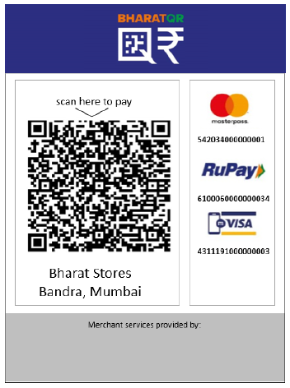
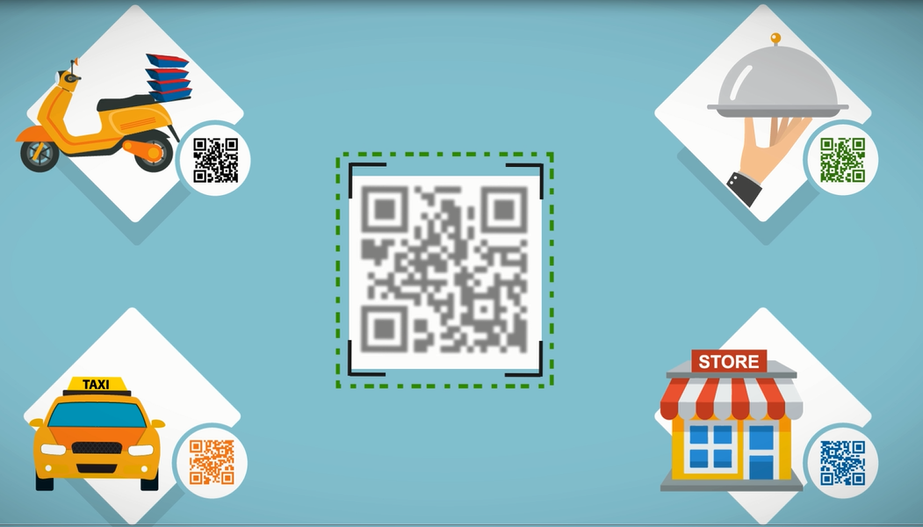
Bharat QR
Multiple QR Codes
Common Bharat QR Code

Slide 16
Bharat QR
Features
Interoperability among QR based payment products of different networks: RuPay, Visa, MasterCard and Amex.
Requirement
Bank application which supports Bharat QR code (Required for the card holder to make payment)
Way forward
22 Acquiring Banks and 12 Issuing Banks live on Bharat QR
Substitute for PoS Terminals.
Low cost acceptance payment solution.
Push based transaction i.e. transaction originates from card holder.
No need to share physical card with merchant.
Merchant’s Bharat QR code (Provided by bank to receive payment)
Future ready to accept payments from other channels like UPI, Aadhaar Pay, IMPS, BBPS

Slide 17
THANK YOU

